Slide 1
Project Veritas User Flows
Presenter Name
Presenter Title | @socialmedia

Slide 2
Instant Verification

Slide 3
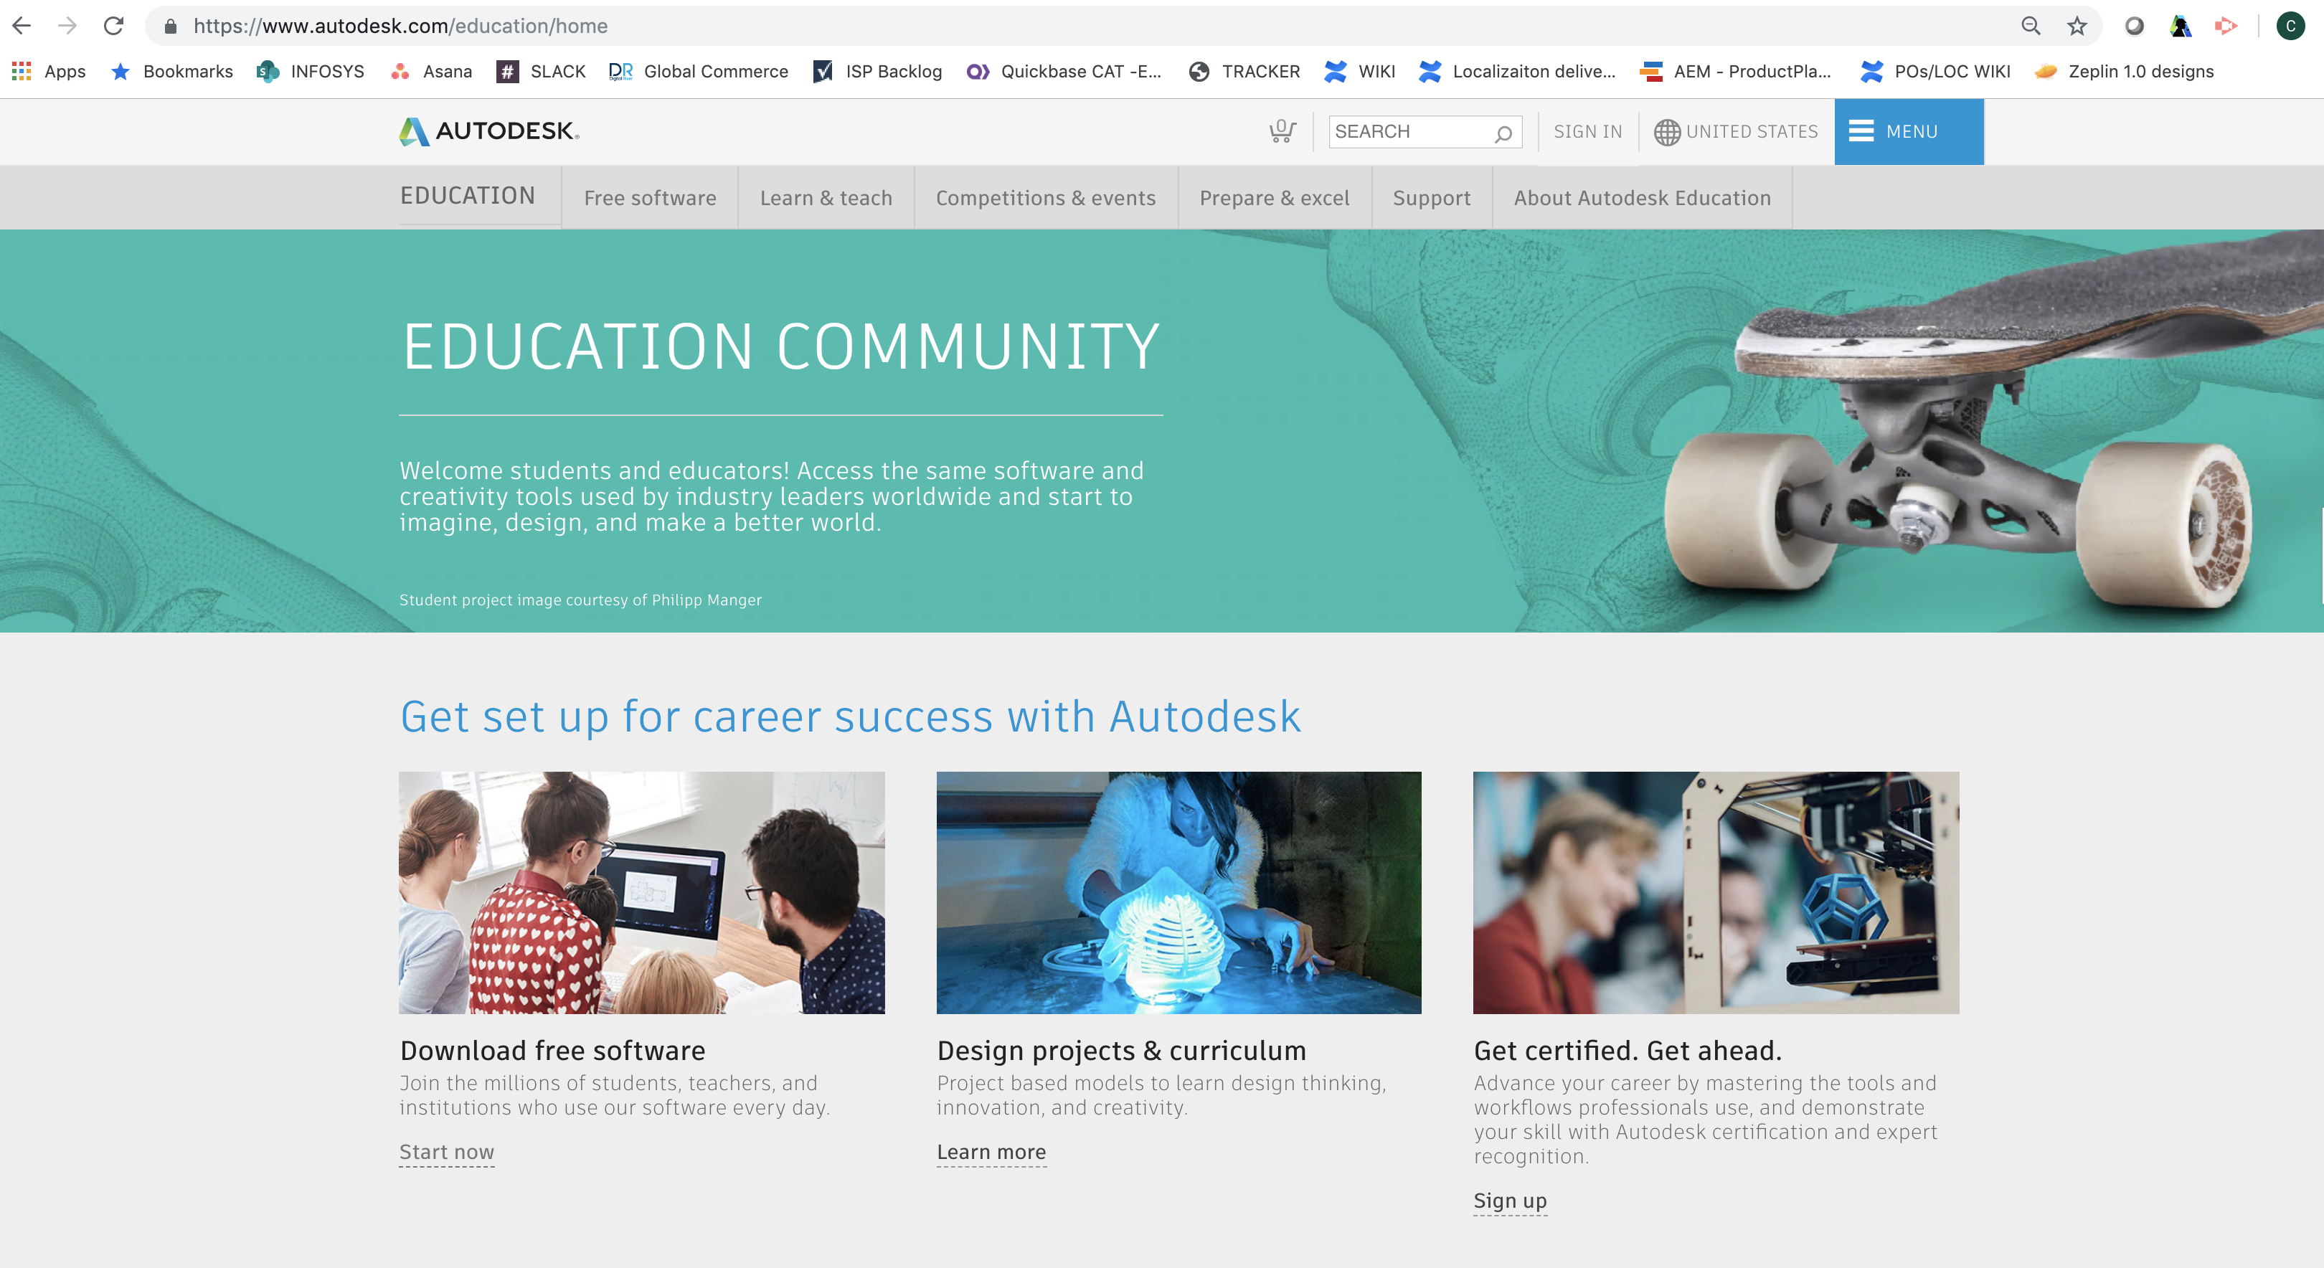
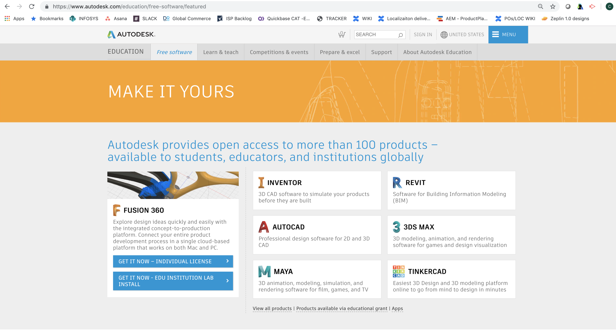
Start in EDU Community

Slide 4
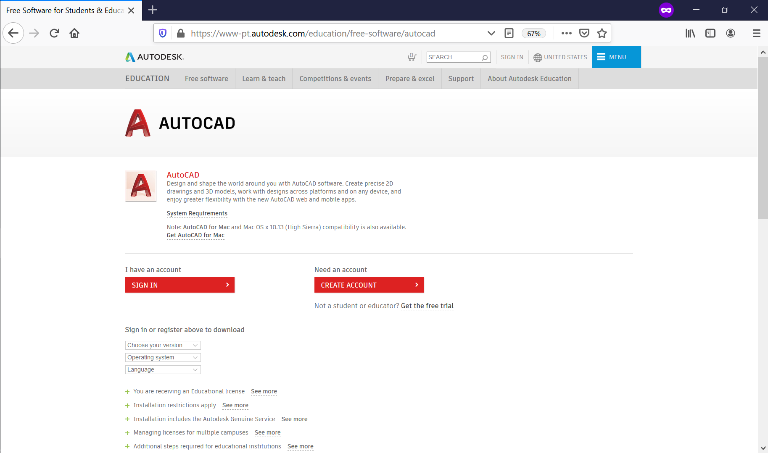
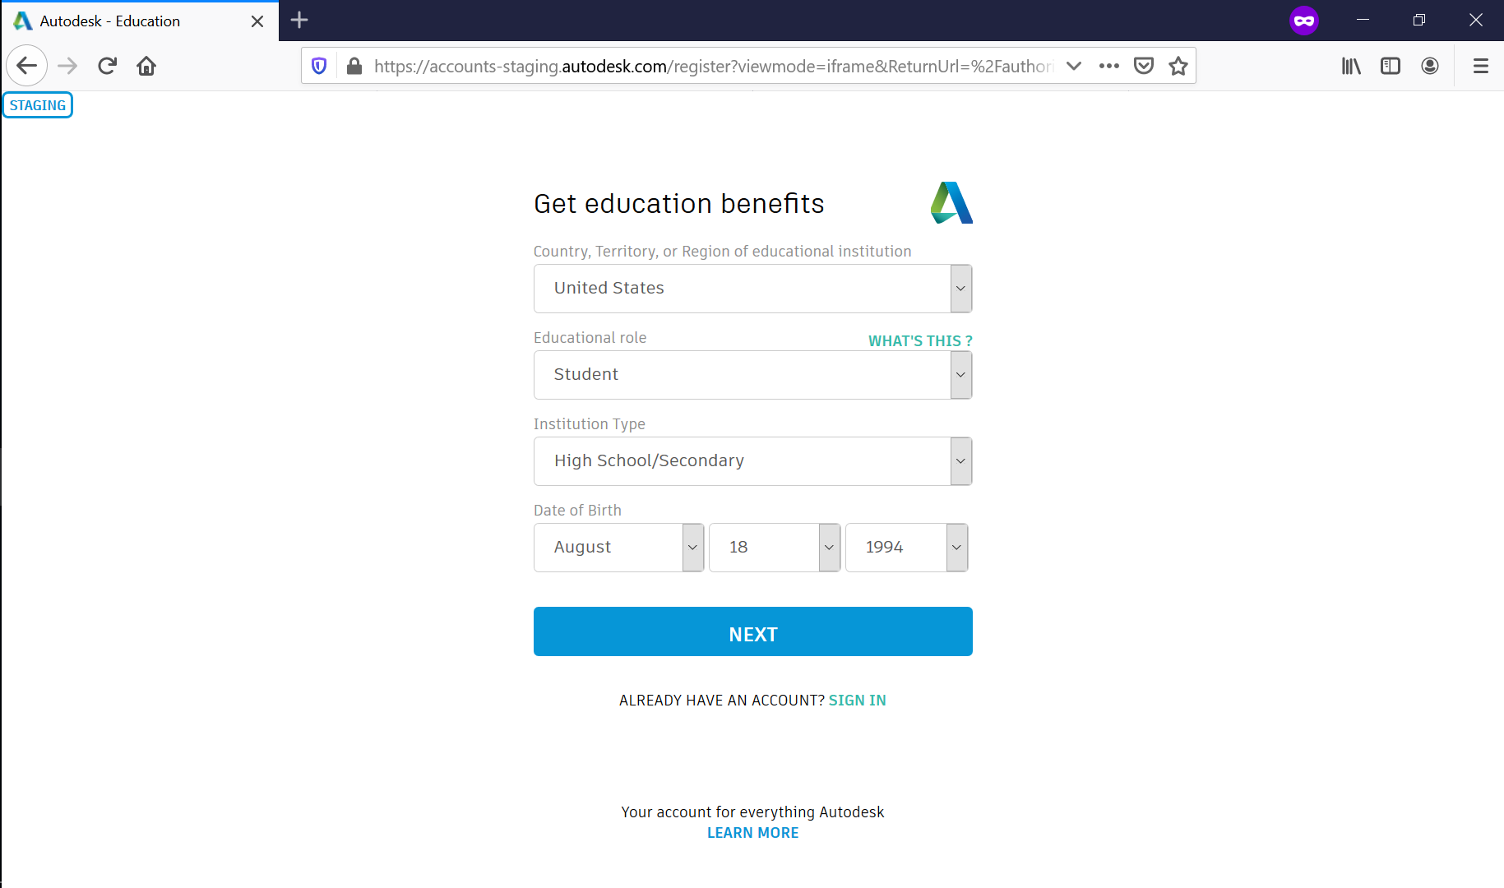
Create ADSK Account with EDU profile details

Slide 5
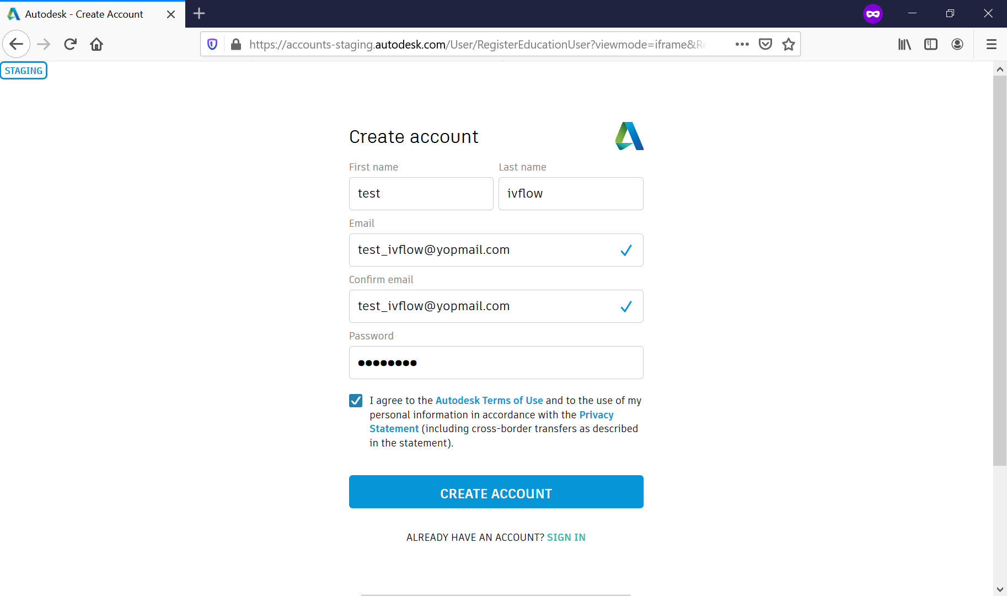
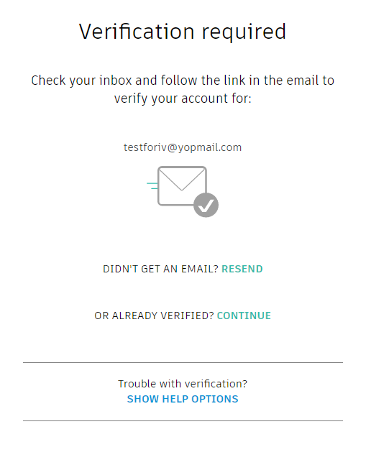
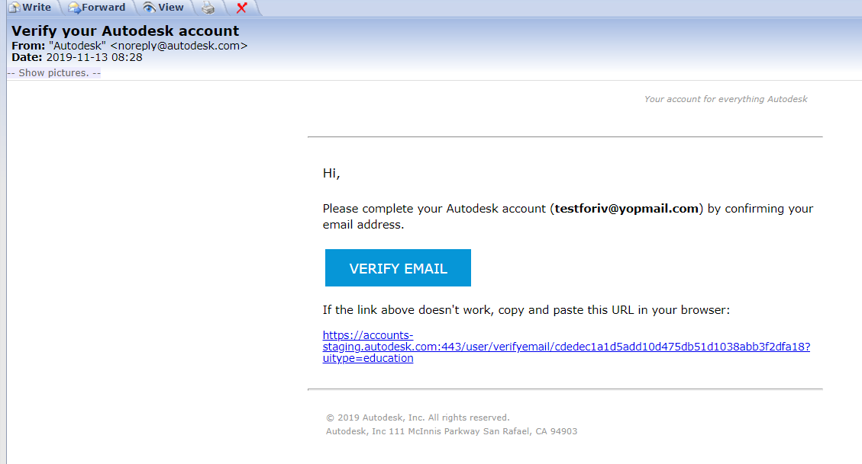
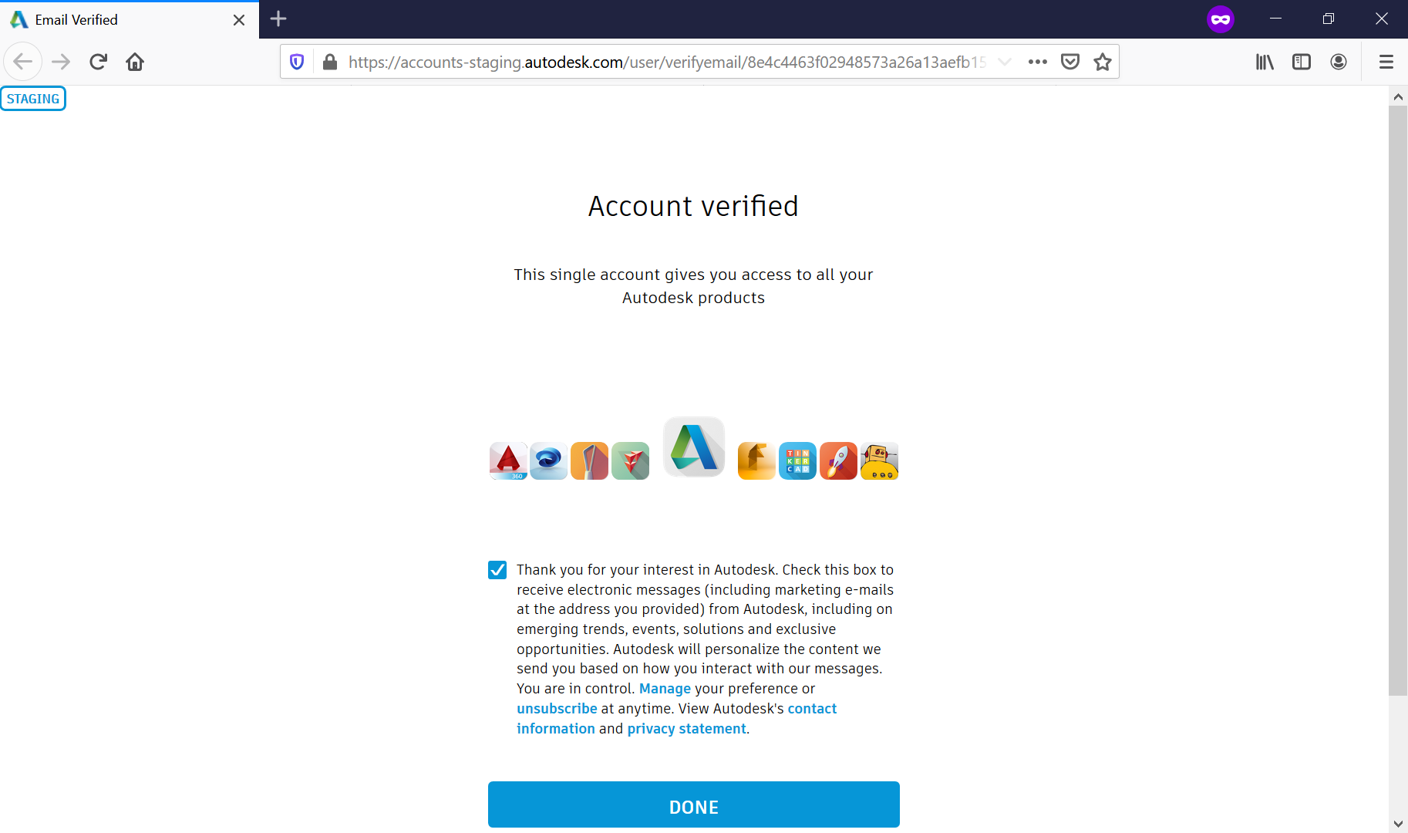
Complete ADSK Account creation and verify email

Slide 6
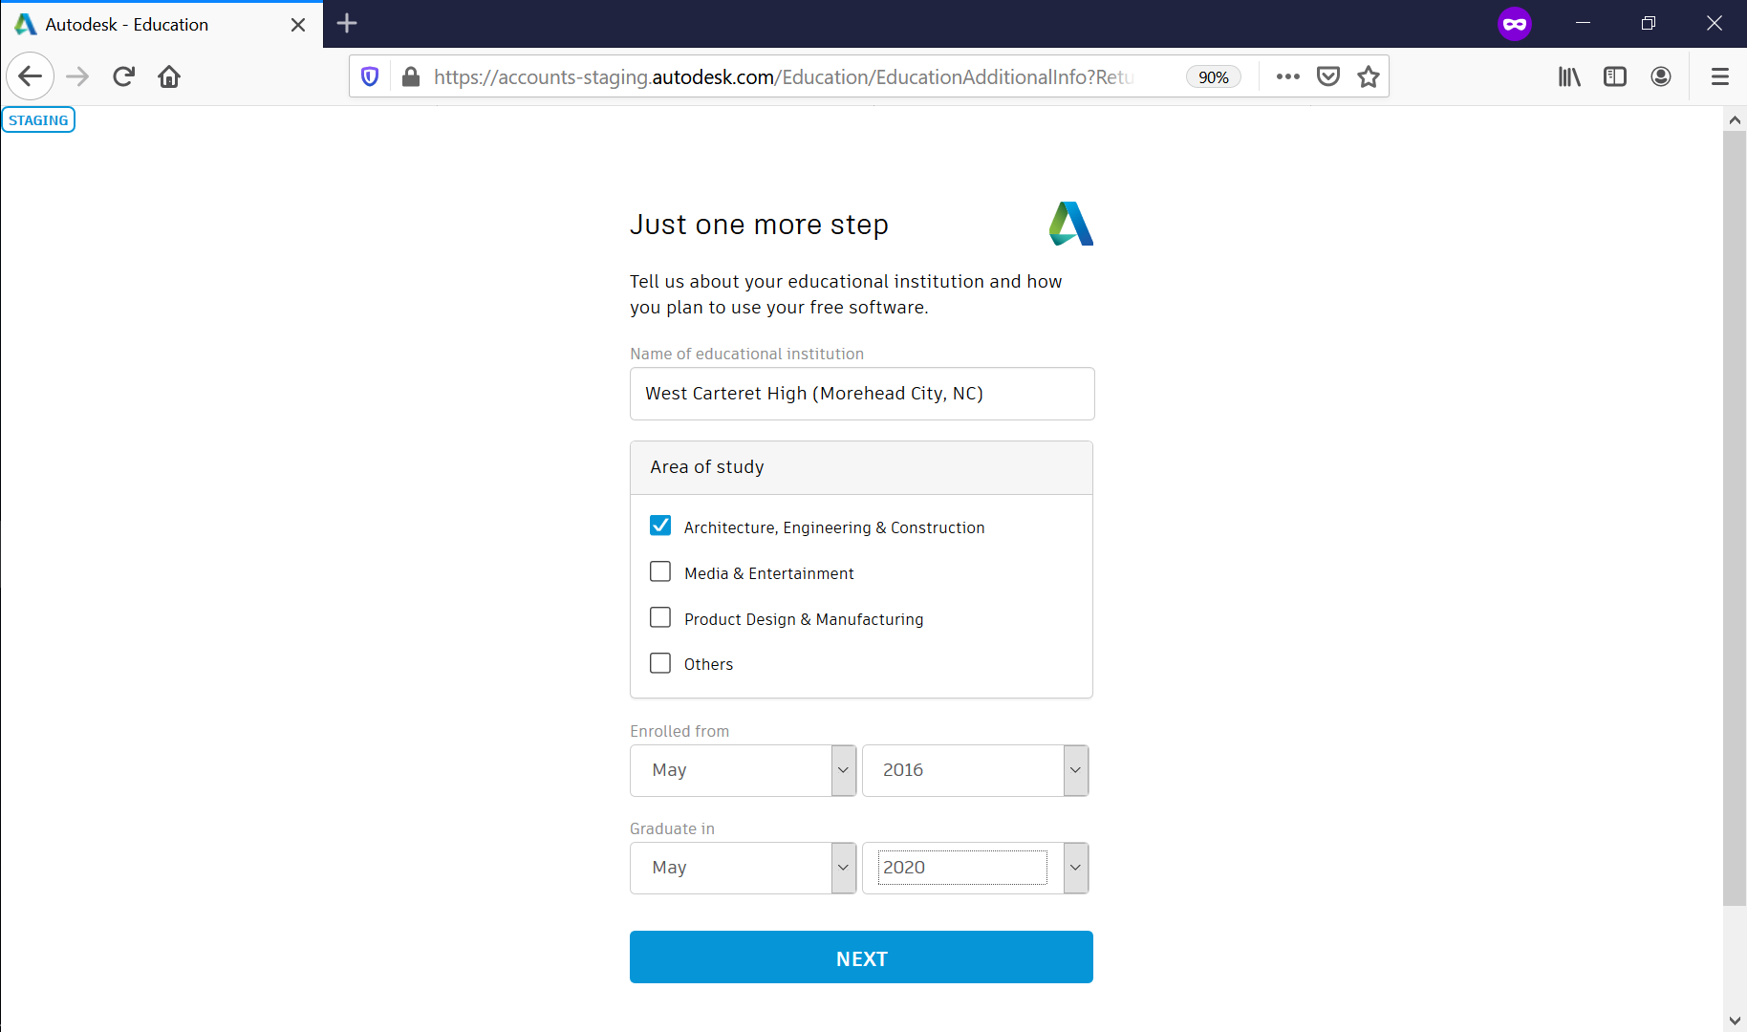
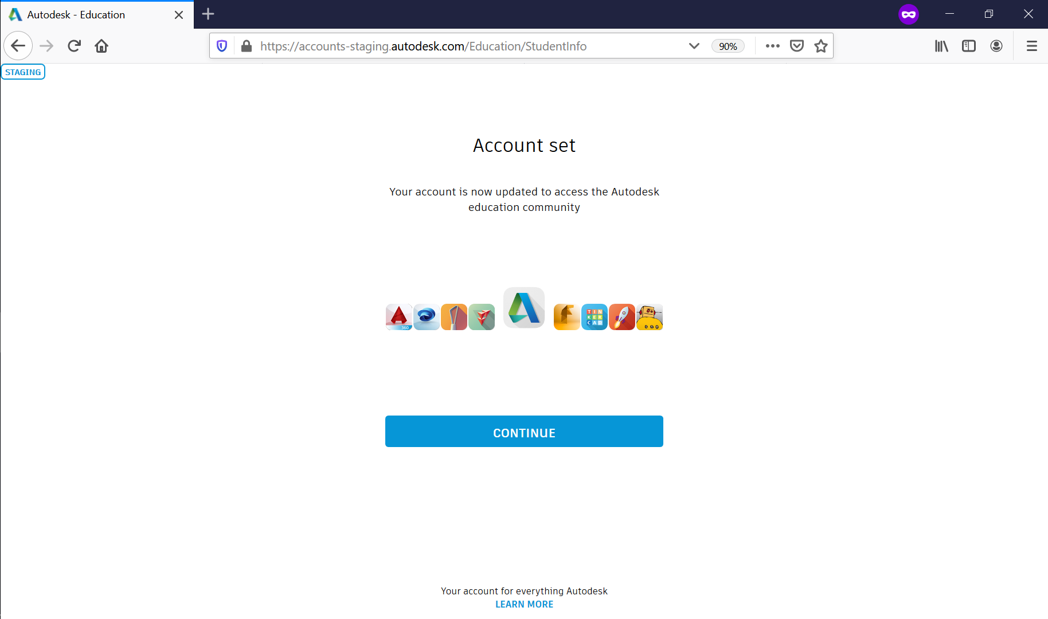
Complete ADSK EDU profile with school details and Verification Trigger on Product Page

Slide 7
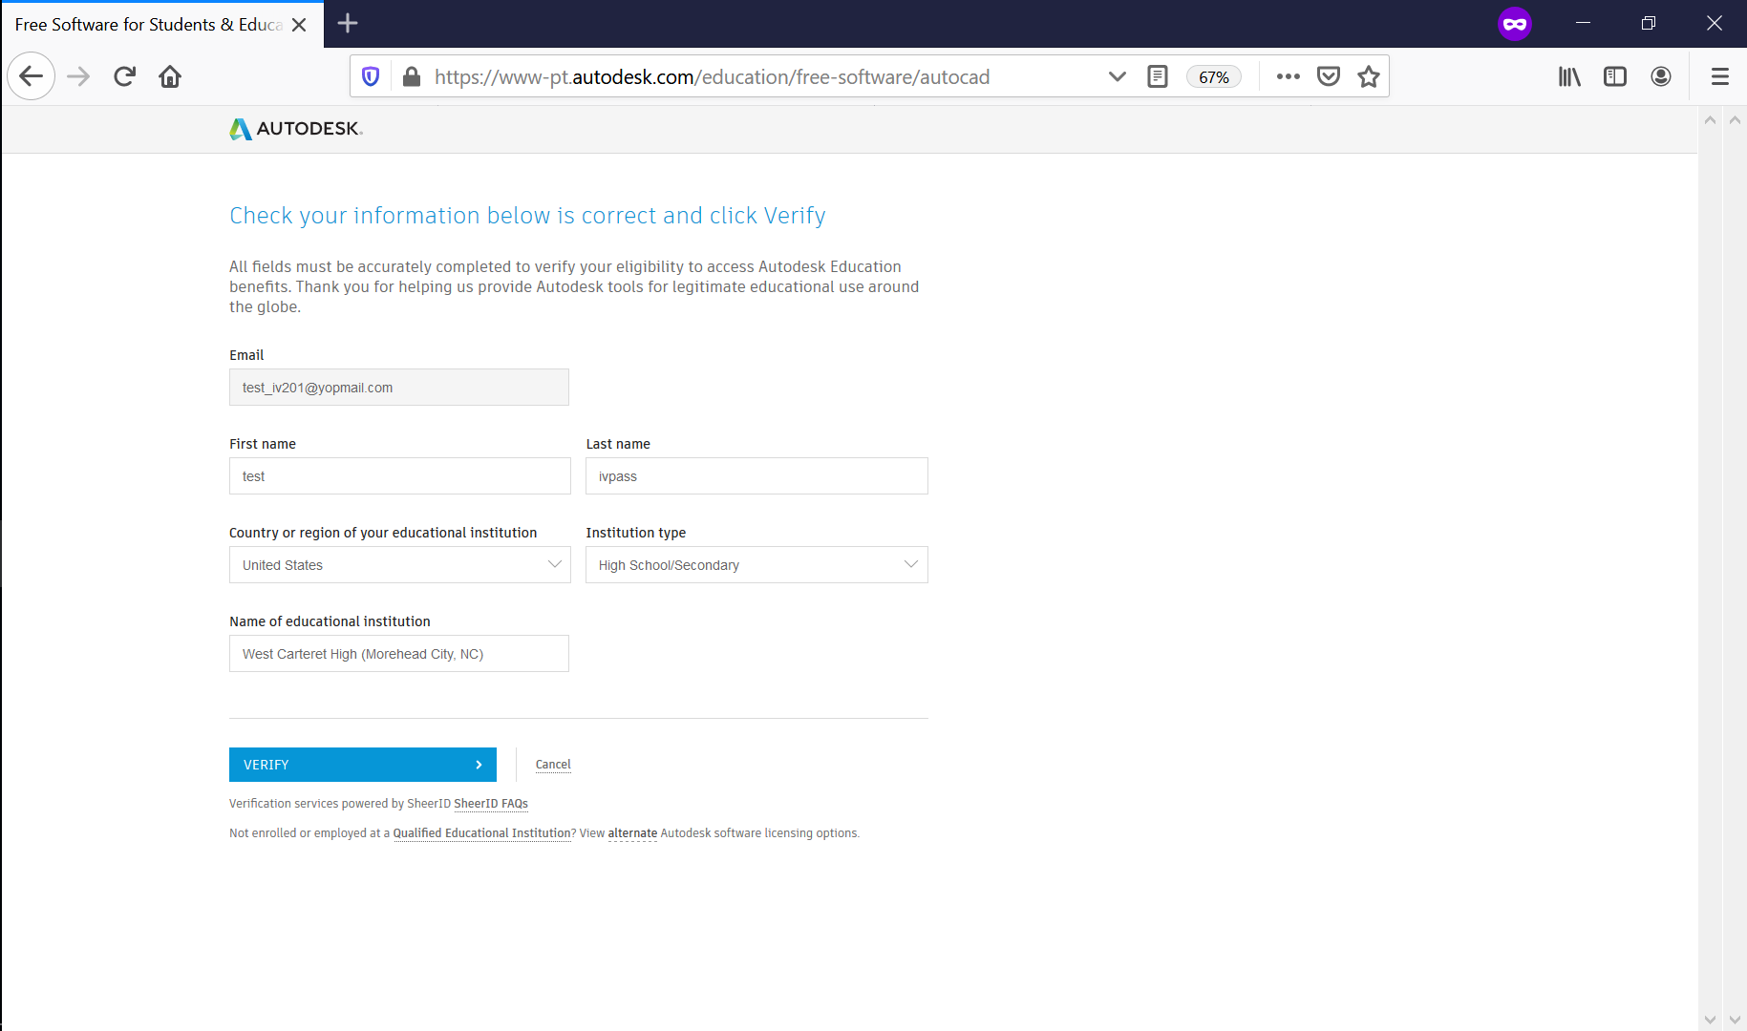
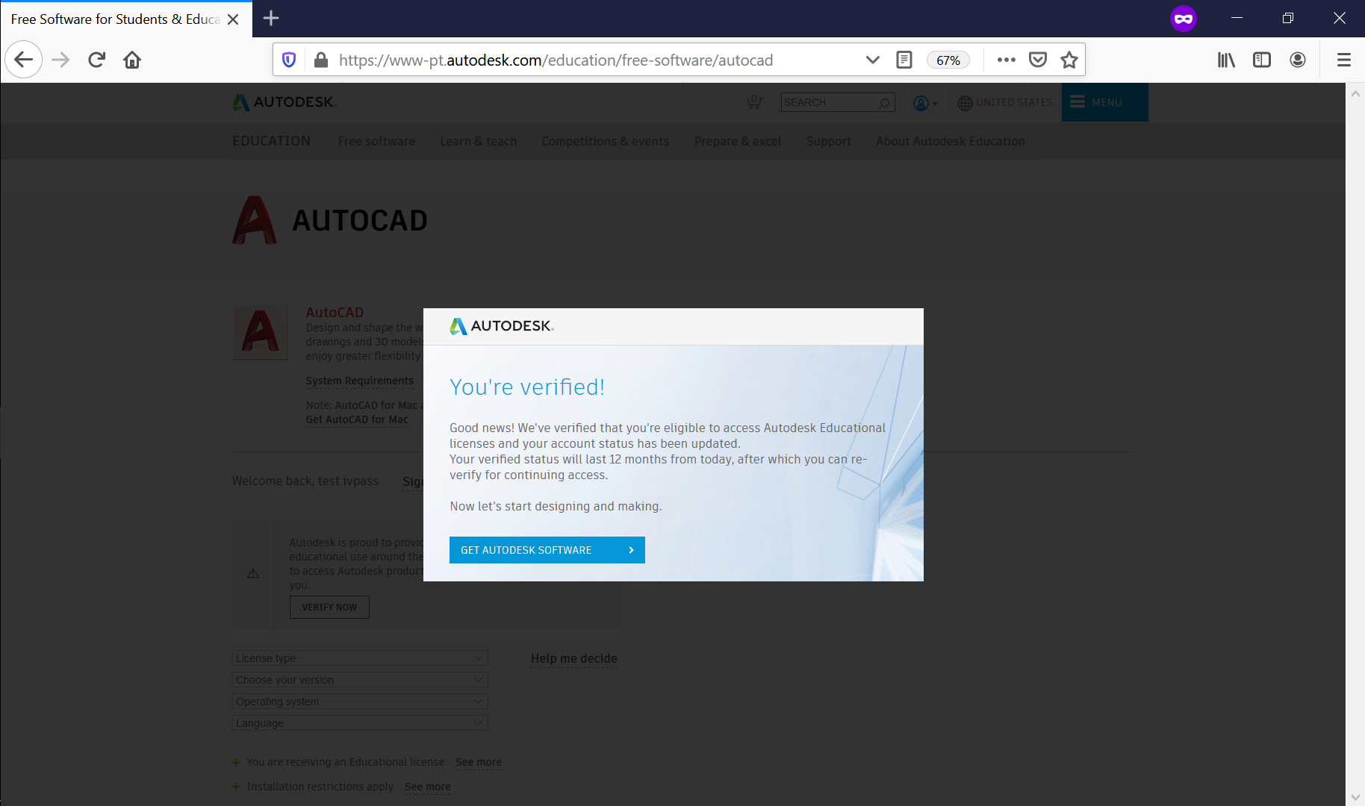
Instant verification succeeds for a valid user with accurate info in their profile

Slide 8
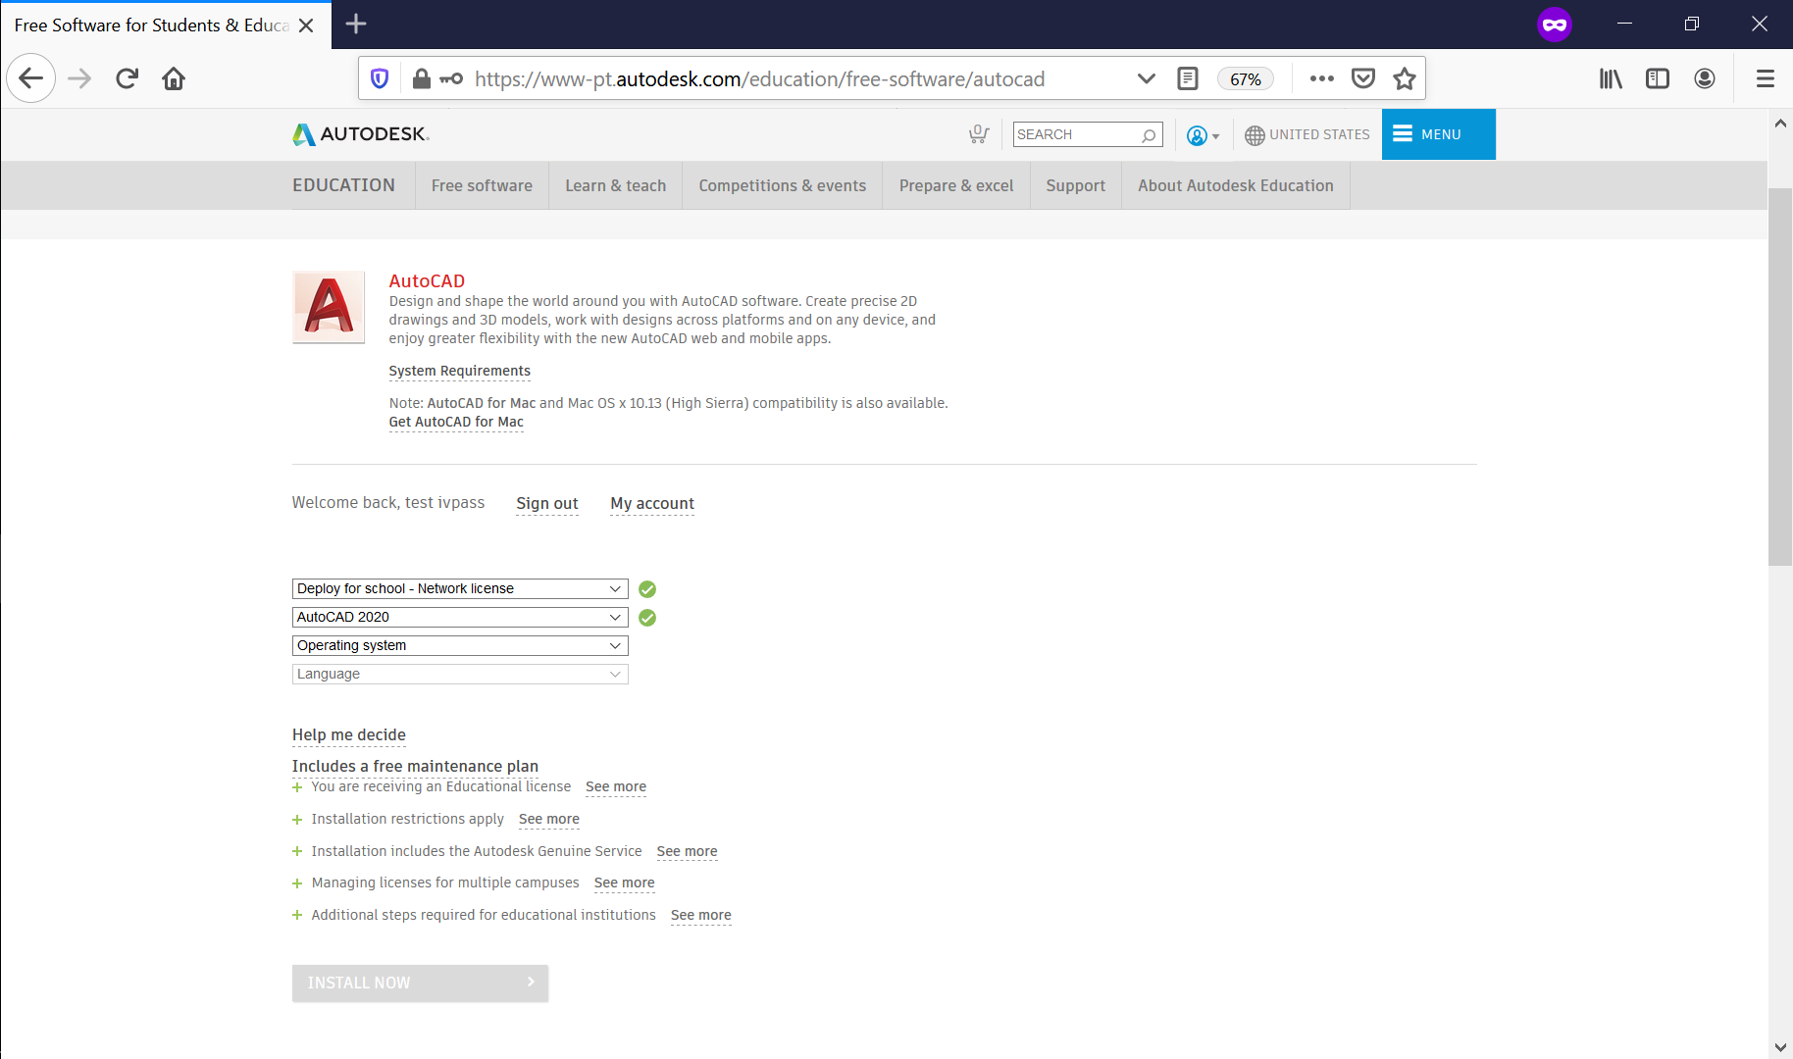
User is able to choose and download the product

Slide 9
Instant Verification flow (Failure)

Slide 10
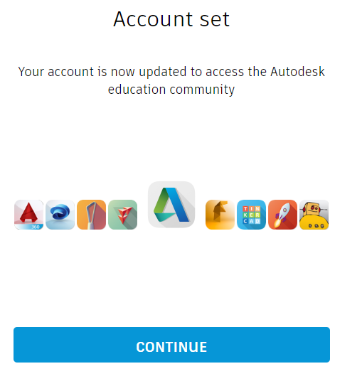
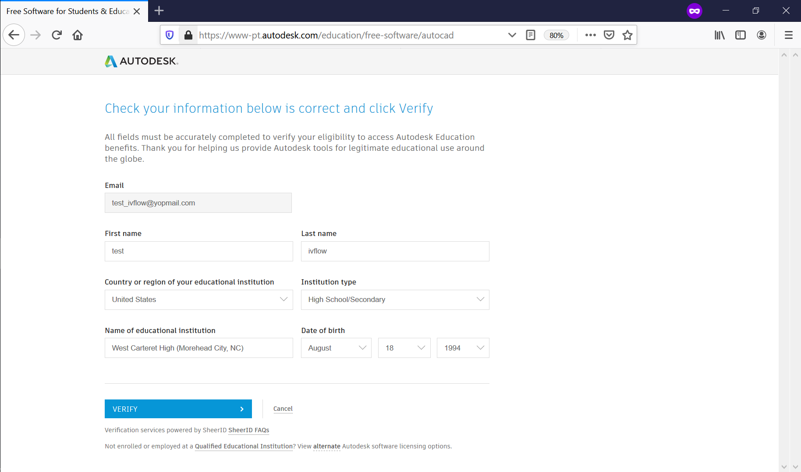
Initiate verification process after Account set during account creation or signing in with an existing edu account.

Slide 11
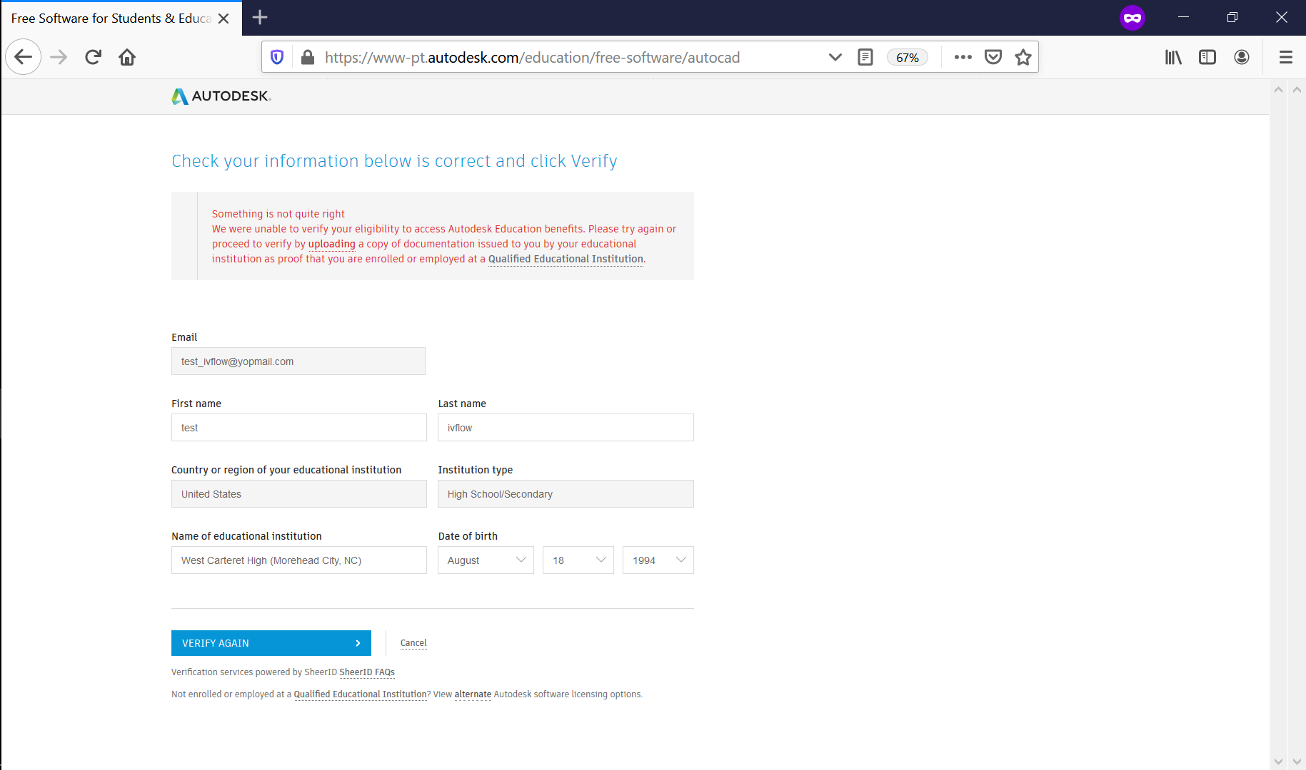
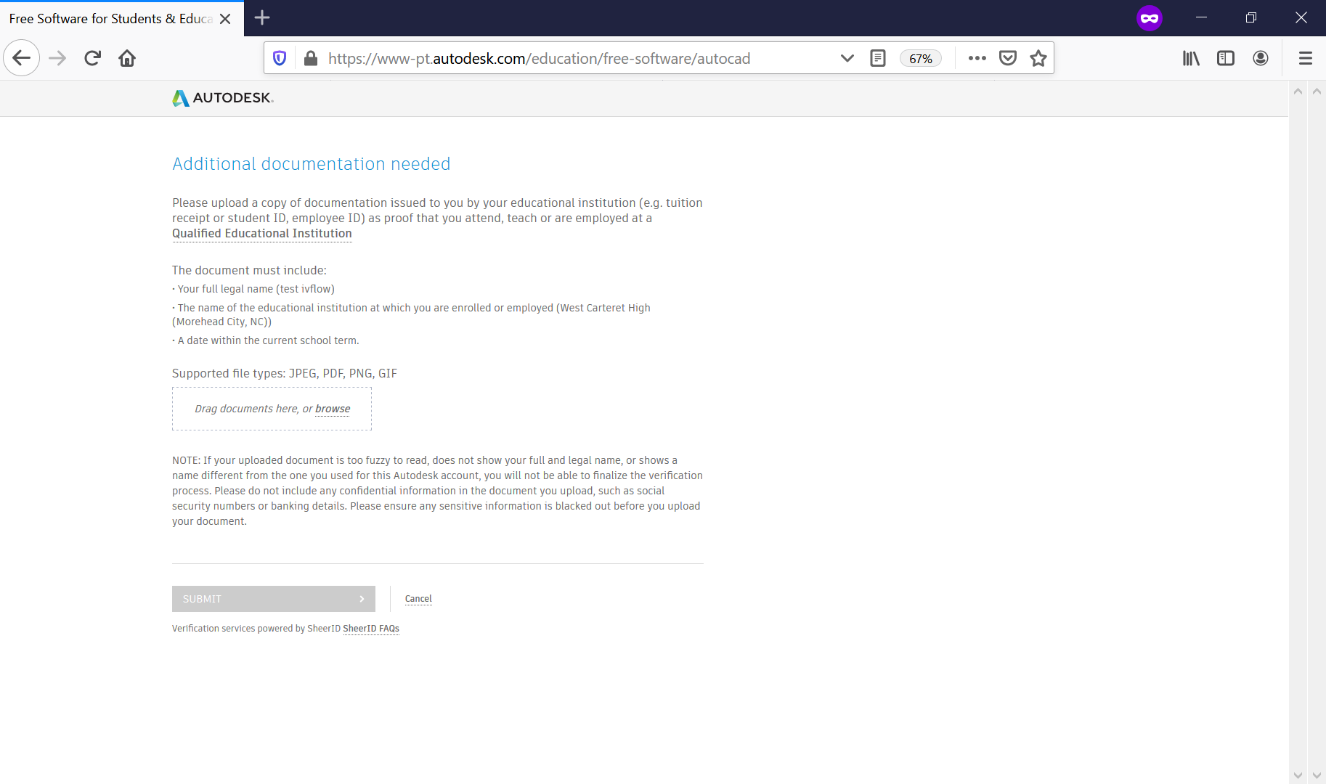
Instant verification fails and user gets a second attempt. If that also fails, user is asked to upload document to verify their eligibility.

Slide 12
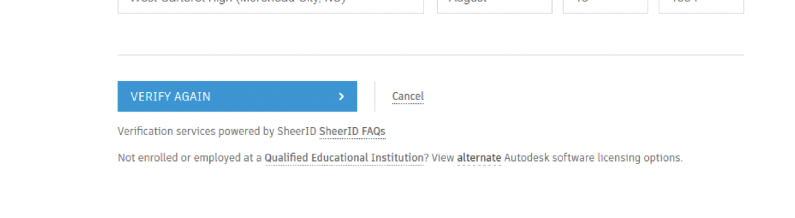
Other Options for Failed User
Soft Landing Page

Slide 13
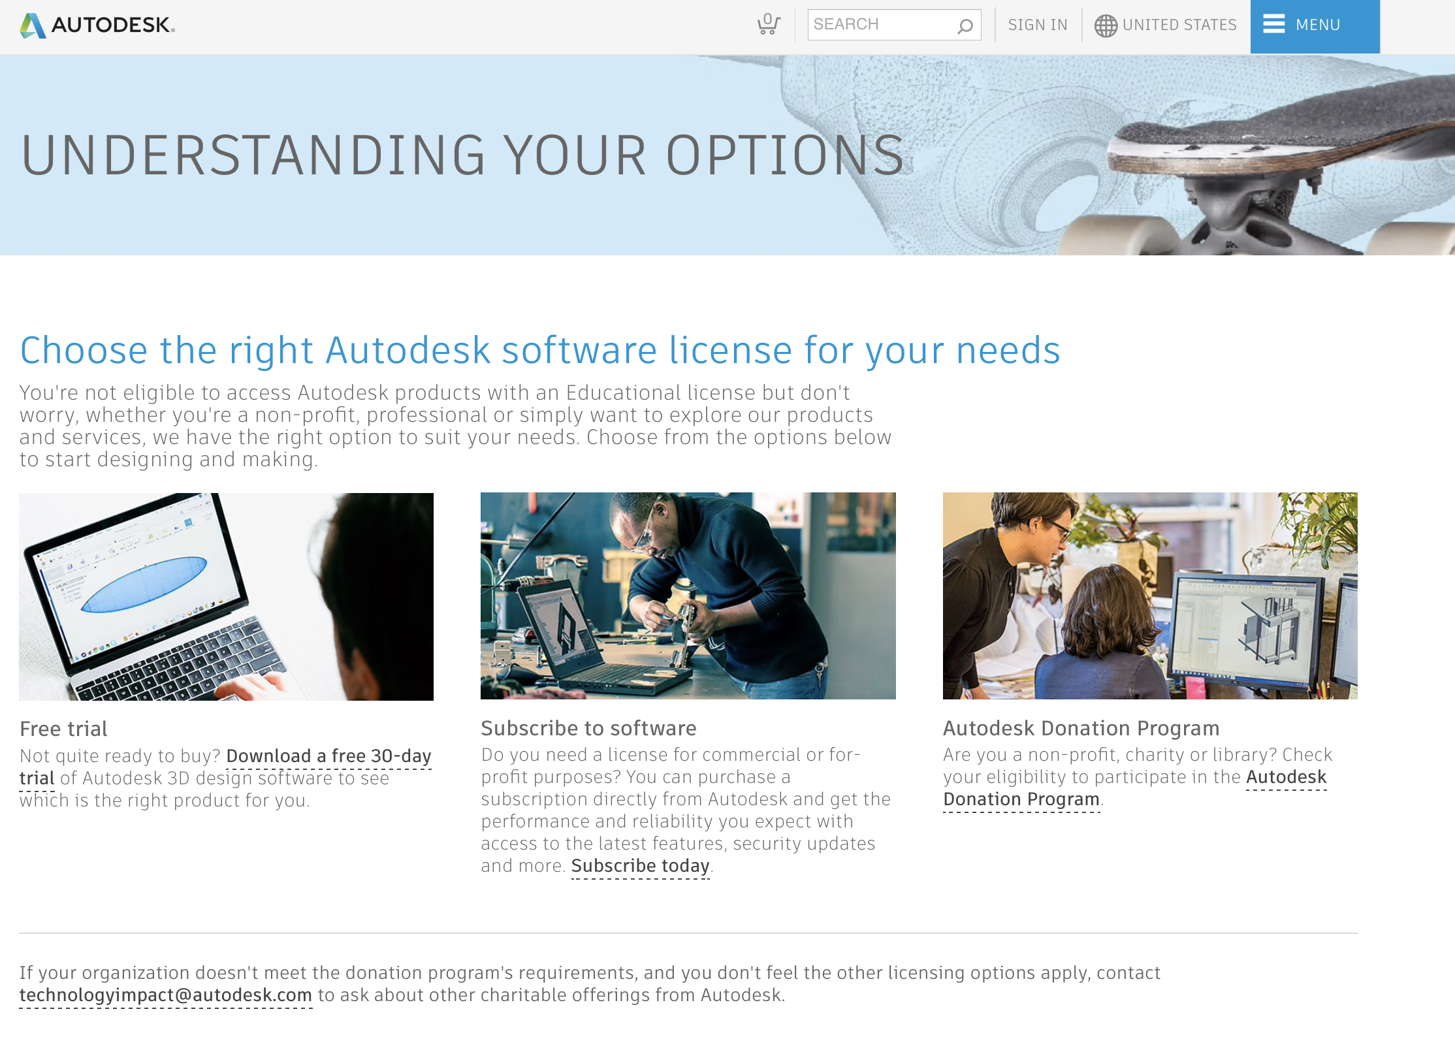
Soft Landing Page – Trial or Subscribe Options

Slide 14
Single Sign On (SSO)

Slide 15
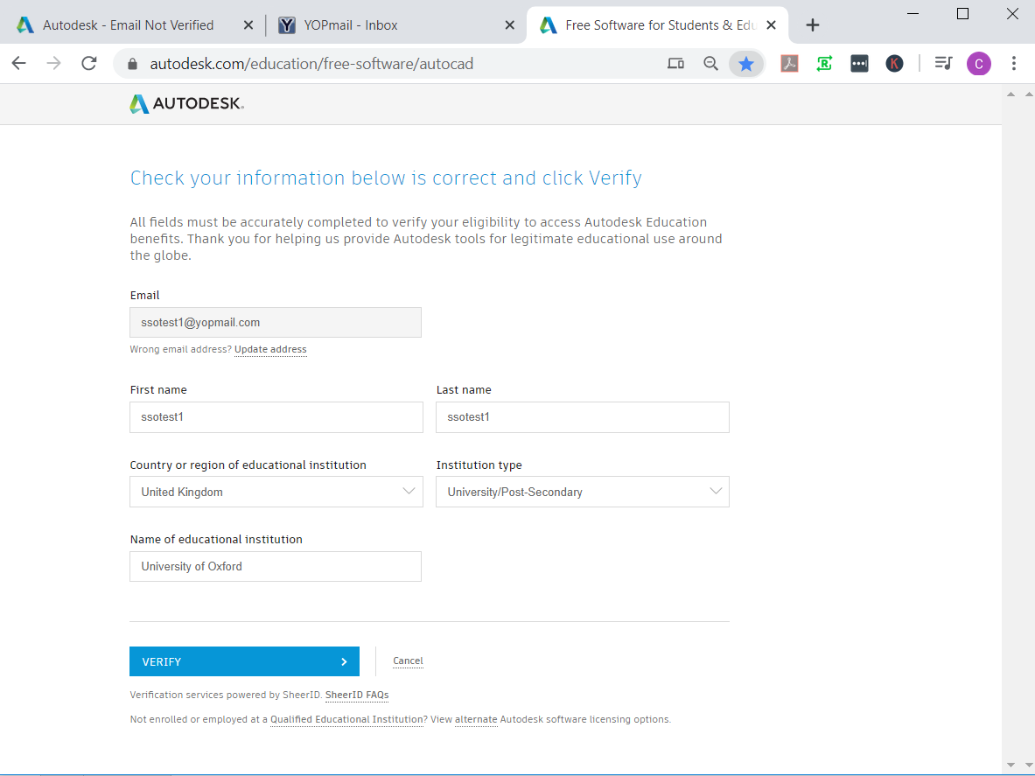
Initiate verification process from O2 Account set page. Prior to this step, user either logs into an existing Autodesk EDU account, or creates a new account (as previously documented in slides 4-6)
Notes:
2/3/20
ssotest@yopmail.com
test1234

Slide 16
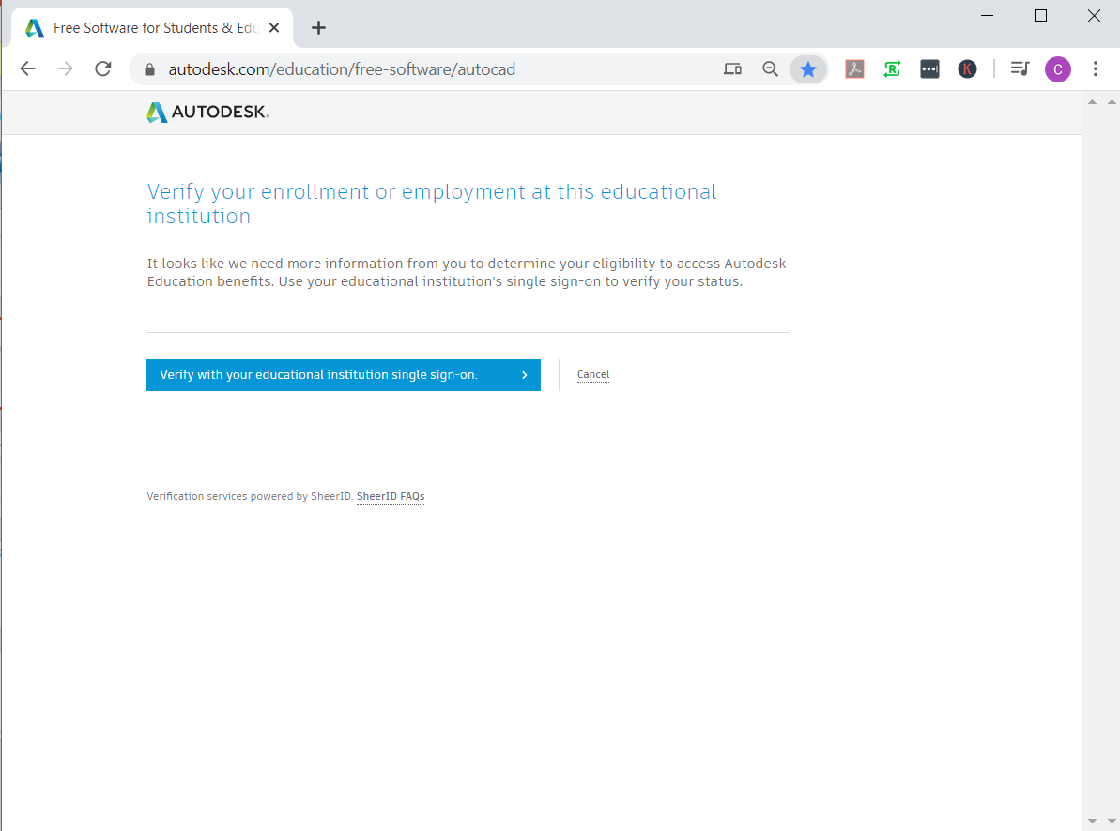
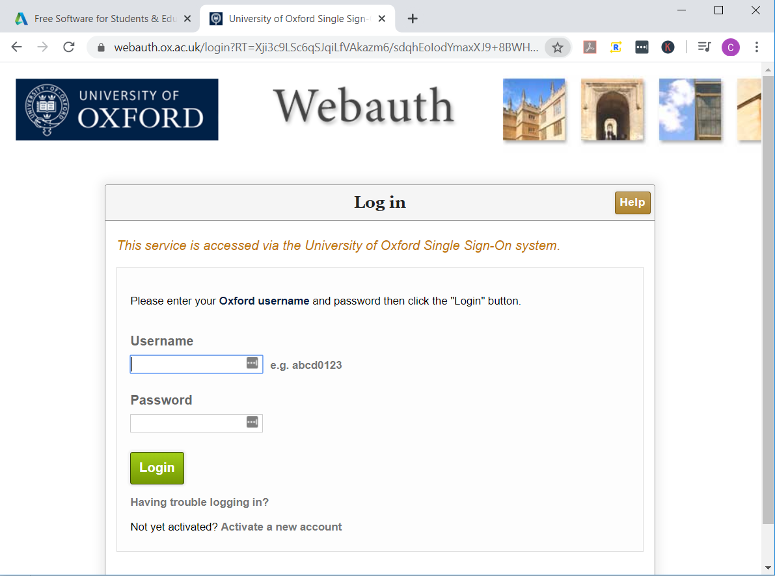
SSO landing page – user clicks CTA and directed to school’s SSO portal in a new tab. Successful SSO login directs to “You’re verified”

Slide 17
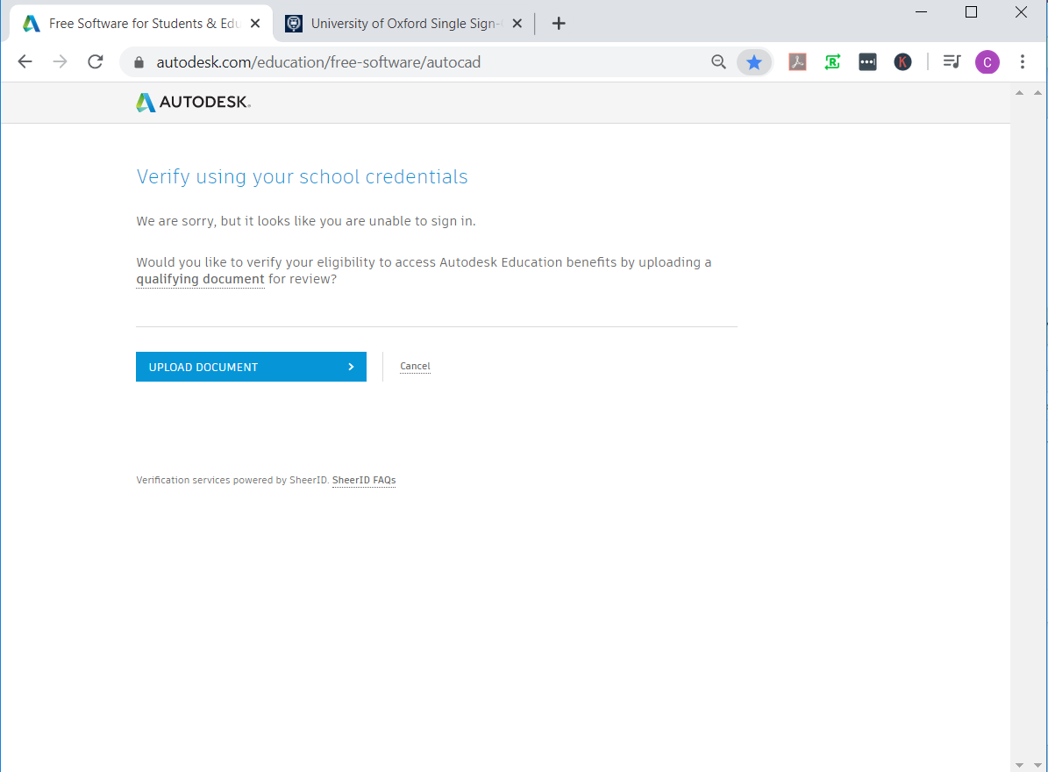
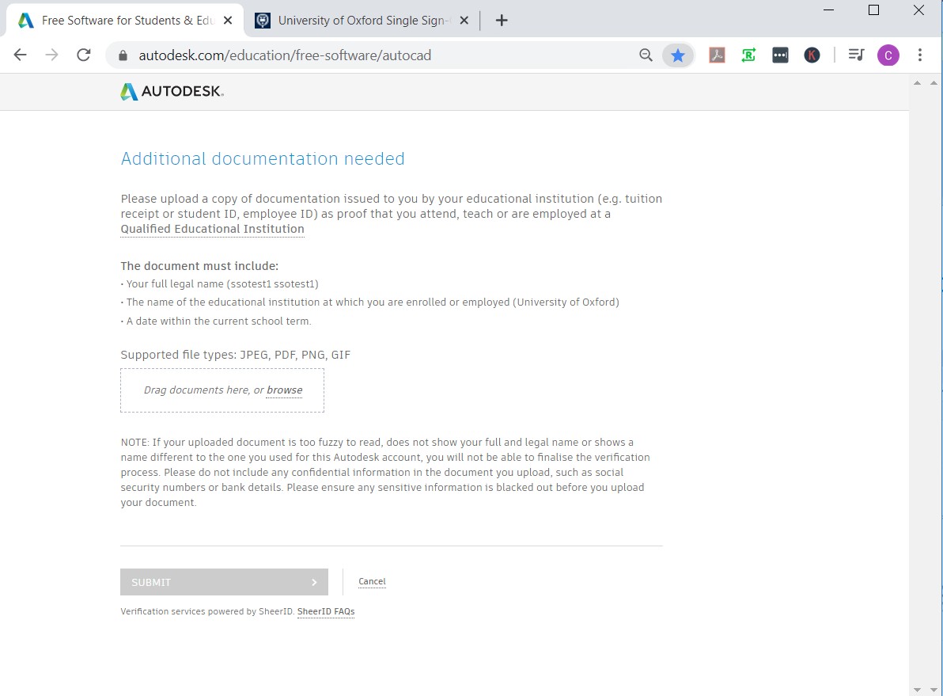
If SSO login not successful, or user does not take SSO step, user can still try Doc Review. SSO Landing page automatically refresh with upload document option. After 2 mins, the page then refreshes to the actual doc upload screen

Slide 18
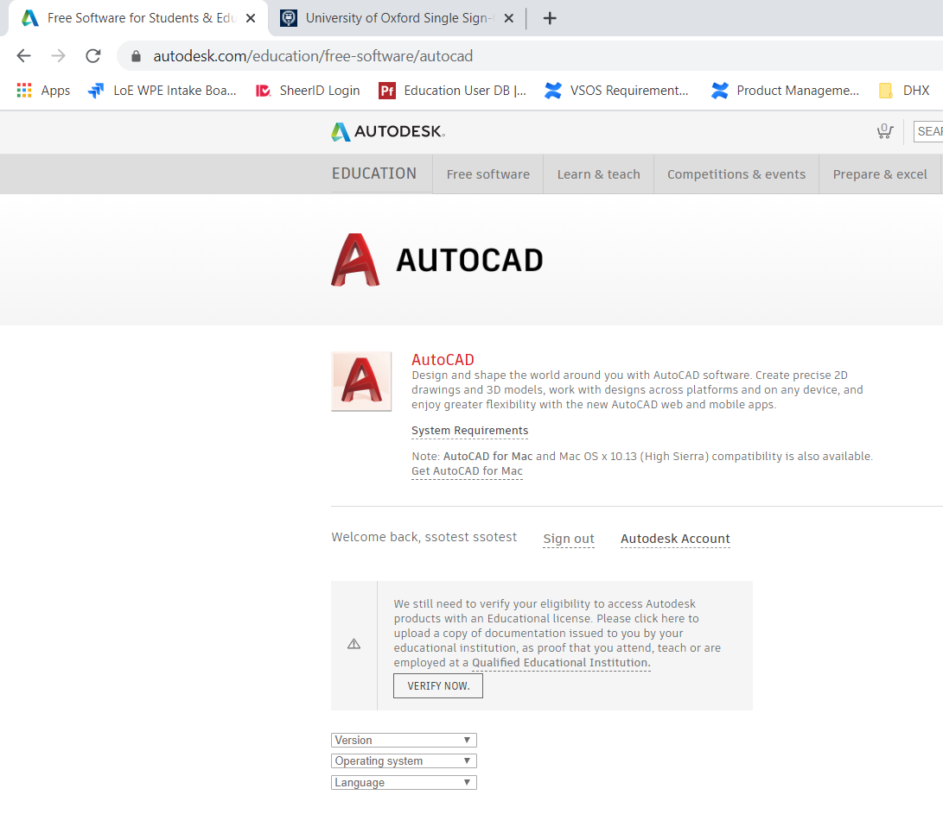
If user does not successfully verify via SSO or DR, they will be prompted to upload a doc upon returning to the product page (as long as verification has not expired)

Slide 19
Document Review

Slide 20
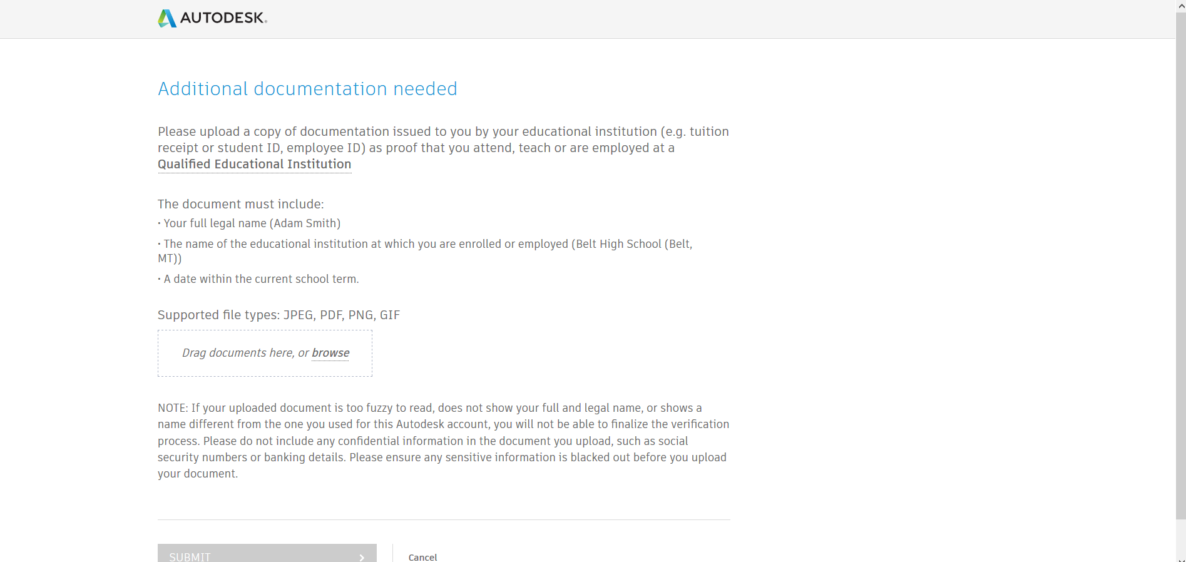
If Instant Verification or SSO attempts fail (or those flows are unavailable to users – primarily secondary institutions and/or certain countries) the user will go through document review.

Slide 21
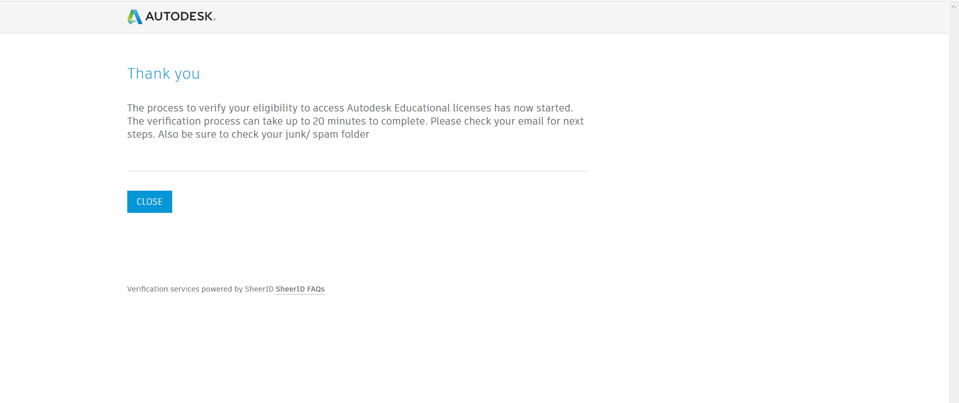
Once submitted for review, SheerID agents will approve/deny, and the user will be notified via email.

Slide 22
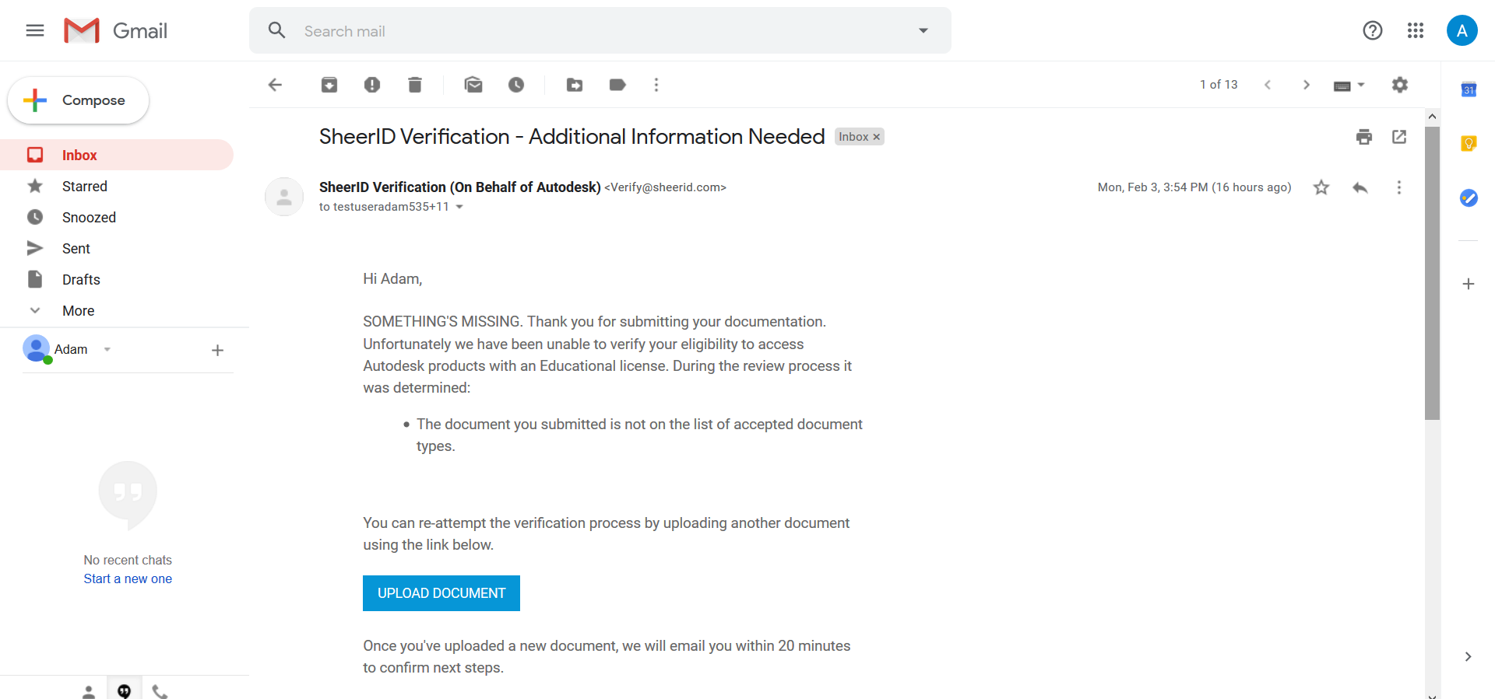
If rejected, the user is instructed to try again (either a new document, or the same document, in a more legible file upload). Users have 3 document review attempts.

Slide 23
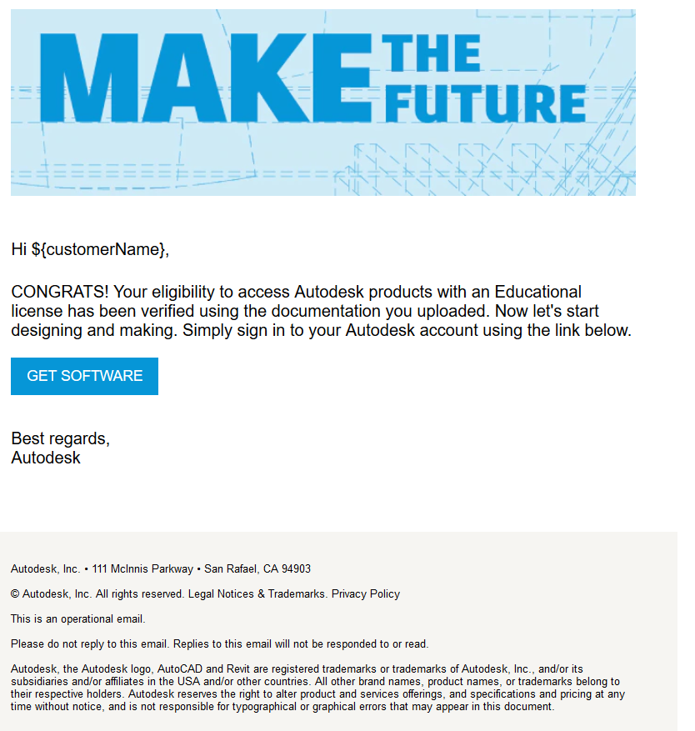
If approved, the user directed back to the EDU product page

Slide 24
User is able to choose and download the product

Slide 25
Add school request

Slide 26
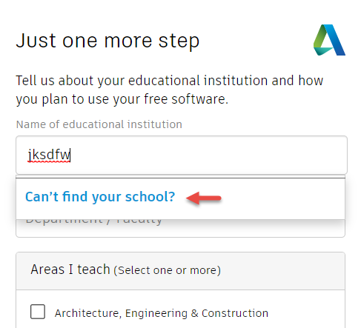
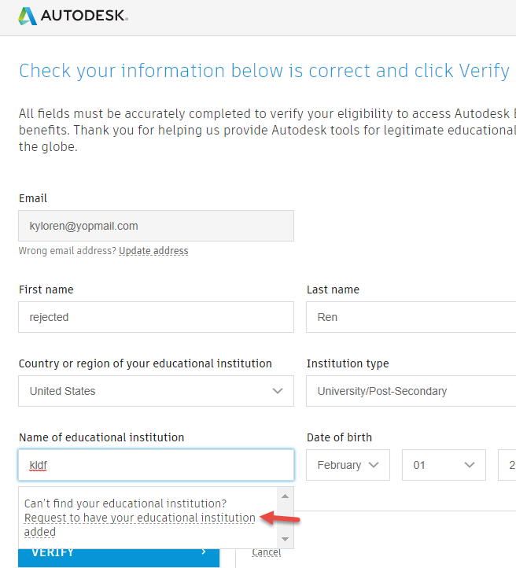
Trigger Add school request from Educational Institution name field
Or in the Verification form
During Account Creation
Notes:
https://offers.sheerid.com/autodesk/add-school-request/?locale=en_US

Slide 27
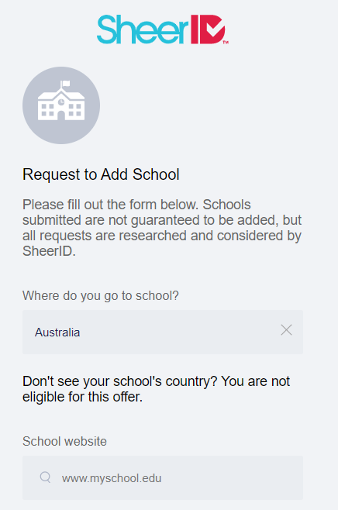
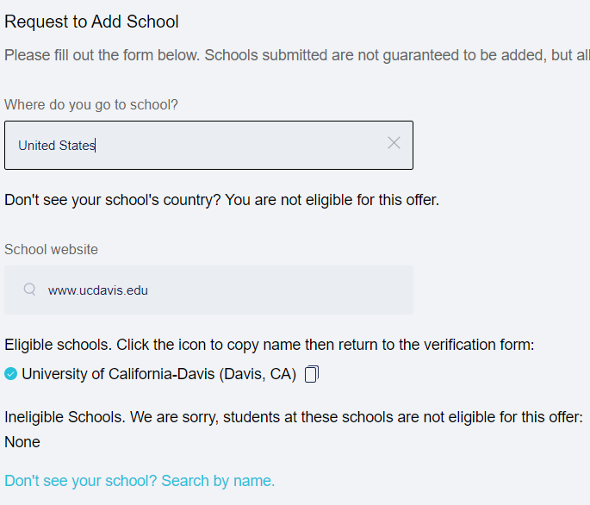
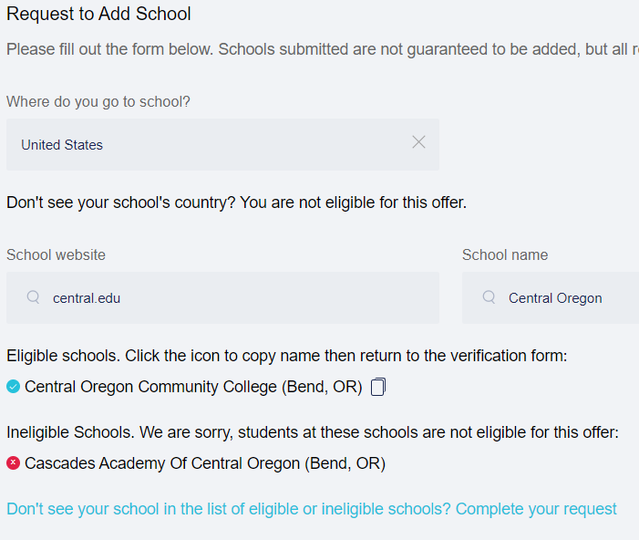
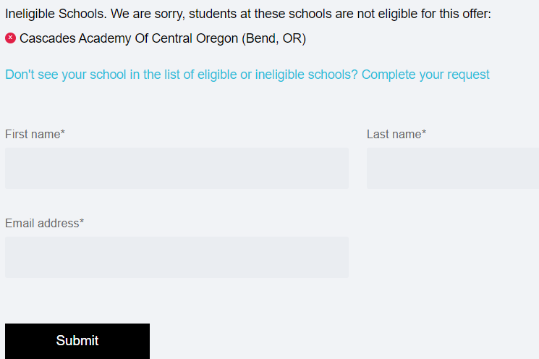
Sheer ID Add School form
Step 1 – check by URL if school is on the list
Step 2 – display if school is already on the list or deemed ineligible
Step 3 – check if school is on the list by school name
Step 4 – If all fails, allow user to enter school details for review/addition
Notes:
https://offers.sheerid.com/autodesk/add-school-request/?locale=en_US

Slide 28
Customer facing emails

Slide 29
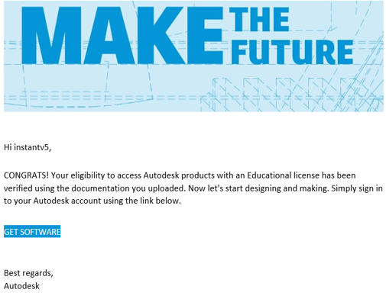
Subject line: You eligibility has been confirmed!
User has pass verification.
CTA: Click to get product

Slide 30
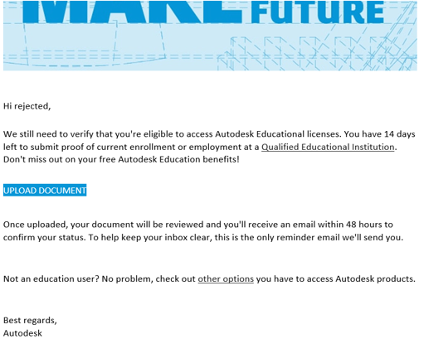
Subject line: Have you forgotten to upload your document?
User is reminded to take the next step and upload documentation within 14 days.
CTA: Upload a document

Slide 31
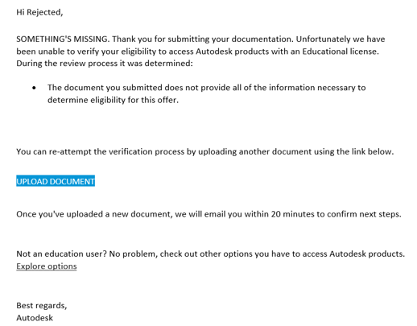
Subject line: Additional Information Needed
User has uploaded a document but more documentation is needed.
CTA: Upload a new document

Slide 32
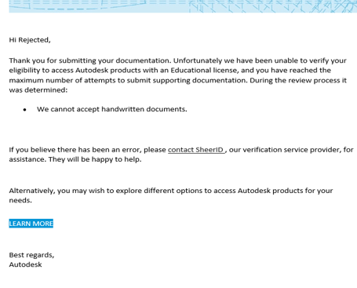
Subject line: SheerID Verification-Unable to verify
User has maxed out of document upload attempts and failed out.
CTA: Visit a landing page for alternative software options (e.g. trial,

